Slide 1
Training A

Slide 2

Welcome
Welcome to the training part of the experiment.
In the first part, we are going to practice describing pictures. You will hear me describe pictures and I will ask you to repeat after me. I will also explain how certain words should be emphasized.

Slide 3

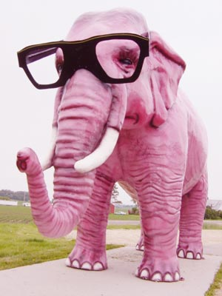
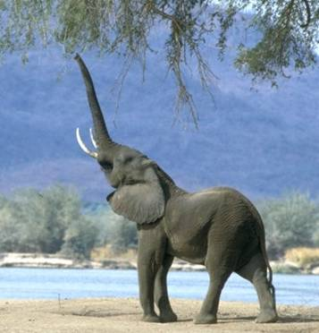
In the following pictures, there are two elephants.
If I want to be more specific about one of the pictures, I can give a detail such as “the pink elephant”. I can also put this in a complete sentence by saying, “The pink elephant is wearing glasses.”

Slide 4
Notice that I am putting emphasis on the adjective “pink”, to make sure that no one gets confused with the other elephant that is not pink.
What does emphasis mean? It means that we make the word louder, longer, and higher pitched.

Slide 5
Listen again: “The pink elephant is wearing glasses.”
Now you try saying it:
“The pink elephant is wearing glasses.”

Slide 6
That’s right: “The pink elephant is wearing glasses.”
Now, let’s describe the other picture.

Slide 7
We can say: “The grey elephant is eating leaves.”
Notice that I put emphasis on “grey” this time, making the word “grey” louder, longer, and higher pitched. This is because I want to distinguish it from the other elephant that is not grey.

Slide 8
Listen one more time: “The grey elephant is eating leaves.”
Try saying it:

Slide 9
Great!
Listen one last time: “The grey elephant is eating leaves”
Say it again:

Slide 10
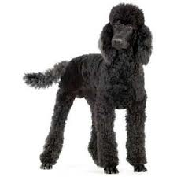

Now, let’s try 2 different pictures.
In the following pictures, there are two animals: a cat and a dog. If I want to be more specific about one of the pictures, I can say “the black cat” or “the black dog”.

Slide 11
If I want to put this in a complete sentence, I could say, “The black cat is sleeping.”
Did you notice that I put emphasis on the word “cat”? Why do we need to do this?

Slide 12
That’s right, because both pictures involve animals that are black – it’s only the type of animal that is different. In order to make it clear to the person we are talking to, we want to emphasize the part that is different.
Listen again: “The black cat is sleeping.”
Now, you say it: “The black cat is sleeping.”

Slide 13
Listen to me say it one more time: “The black cat is sleeping.”
Now, let’s describe the other picture with the following sentence: “The black dog is awake.”

Slide 14
Listen to me say it again: “The black dog is awake.”
Notice that I put emphasis on “dog” this time.
Now you try it: “The black dog is awake.”

Slide 15
Great, listen one last time: “The black dog is awake.”

Slide 16
Real compliment vs. indirect insult?
Now, let’s move on to another topic.
You may know that in English, by changing the words we emphasize or by changing how they are emphasized, this can easily change the meaning of the sentence.
I am now going to teach you about an intonation pattern that you probably aren’t aware of.

Slide 17
Real compliment vs. indirect insult?
I’m going to teach you two different ways to say the same sentence.
They each have a different meaning, but only the intonation changes.
Suppose we are talking about movies.
Sentence: “I liked the special effects.”
Depending on how it is said, it can have a positive or an overall negative meaning.

Slide 18
Meaning: positive
Let’s start with the positive meaning. This is the normal way to say it and it is a true compliment.
“I liked the special effects”

Slide 19
Meaning: positive
This is a typical sentence where the pitch falls at the end.
The line graph below shows how the pitch of my voice goes up and down throughout the sentence. Only pay attention to the part that is circled.
I liked the special effects

Slide 20
Meaning: positive
You can listen to the sentence again and match it to the graph.
Try saying it that way: “I liked the special effects.”
I liked the special effects

Slide 21
Meaning: negative
Next, let me teach you how the negative meaning is pronounced:
“I liked the special effects…”
Did you notice that the word “effects” was emphasized?
But what does it mean when we say it this way?
First, imagine the dialogue between two friends, Karen and Jill, on the next slide.

Slide 22

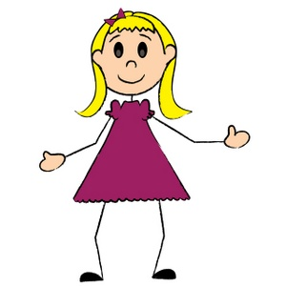

Meaning: negative
So, did you like the movie last night?
Jill
I liked the special effects…
Karen

Slide 23
Did you notice that Karen didn’t directly answer Jill’s question?
However, her meaning is conveyed through the intonation of her sentence.
Karen is trying to be nice by first saying something positive about the movie. However, what she really means, is that the special effects were the ONLY things she liked about the movie. Therefore, it has an overall negative meaning, and she is gently making an insult.

Slide 24
If she wanted to be very honest with Jill, she could follow that sentence with “…but I didn’t really like the movie that much.”
Even if she doesn’t continue her statement, we can understand that she didn’t like the movie, and was just trying to be polite.

Slide 25
We know this by how she changes the pitch of her voice.
Look at the following line graph: this shows how the pitch of the voice changes throughout the sentence.

Slide 26
Did you see and hear how the pitch of the voice rises and falls on the final word “effects”? It also rises at the very end.
This tells us that there is an implied negative meaning.
You can listen to the sentence again and match it to the graph.
Now you try saying it: “I liked the special effects…”

Slide 27
A compliment with the normal falling intonation at the end of the sentence has a positive meaning.
It could easily be a response to the question “What did you like about the movie?”
Whereas, a compliment with a rising-falling intonation at the end of the sentence has an overall negative meaning, and is an indirect insult.
The meaning of the sentence depends on how we change the pitch of our voice throughout the sentence.

Slide 28
One more pattern…
Let’s look at one more intonation pattern.
As we said before, normally there is a falling intonation at the end of a sentence.
However, sometimes other words can be emphasized (as we learned with the first pattern – contrastive stress).
Now, if the main verb in the sentence has a falling-rising intonation, this indicates that the speaker is unsure about whether the action is actually true or was correctly completed.

Slide 29
The next sentence has two possible meanings, depending on its intonation.
“The milk smells okay…”
Meaning 1: It’s drinkable
Meaning 2: But we’re not sure whether it tastes ok.
How would the sentence sound for these two meanings?

Slide 30
Meaning 1: “It’s drinkable”
“The milk smells ok…”
Practice saying it.
Then, look at the line graph below and notice how the pitch is falling on the word “smells”. This is what a normal English sentence sounds like.

Slide 31
Meaning 1: “It’s drinkable”
Here, I’ll say it again: “The milk smells ok…”
You try saying it again.

Slide 32
Meaning 2: “We’re not sure that it tastes good”
“The milk smells ok…”
You try saying it.
Then, look at the line graph below and notice how the pitch goes down and up on the word “smells”. This is typical of a sentence with uncertainty about the action or result.

Slide 33
Listen one more time:
Try saying it again: “The milk smells ok…”

Slide 34
Did you notice that the pitch also rises again at the end of the sentence?
This is typical for sentences that involve uncertainty or a hidden meaning.

Slide 35
Conclusion
When a word is contrastively emphasized in a sentence, the meaning is directly related to it.
Rising-falling pitch on the final word of a compliment sentence indicates an indirect insult.
Falling-rising pitch on a verb indicates uncertainty or overall negativity for the sentence.
Rising pitch at the end of a sentence is usual for sentences where there is uncertainty or a hidden meaning.
Falling pitch is used for neutral sentences that have no hidden meaning.
Ready for a final 10 minute test?
Let’s see what you’ve learned.

